Slide 1
Dart Scoreboard Project: Architectural Design
Ben Houser, Anthony Dohogne, Marshall Rosenhoover, Tyler Ball

Slide 2
Project Overview: Dart Scoreboard
Two GUIs: Scorekeeper and Scoreboard
User inputs throws into scorekeeper
Scoreboard updates with current scores
Scoreboard also displays statistics
Key Decisions:
Using Python for back-end and HTML/CSS/JS for front end
Using a Flask server to host back-end

Slide 3
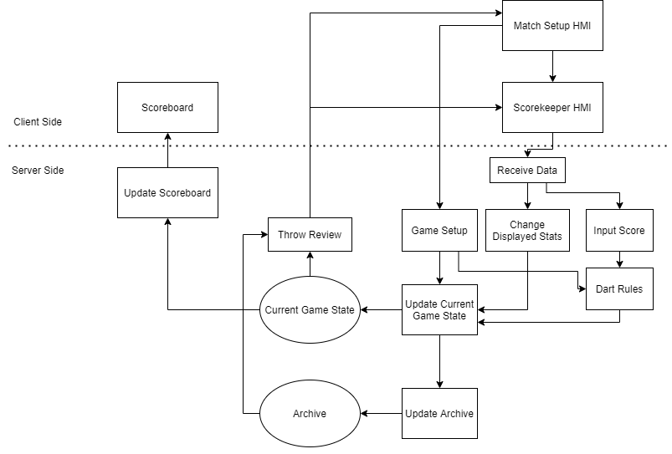
Architectural Diagram

Slide 4
Components
Match Setup
Scorekeeper HMI
Receive Data
Dart Rules
Update Current Game State

Slide 5
Data Storage
Three Tier Architecture
Improved Data Integrity
Easy to Maintain and Modify
SQL Database

Slide 6
Data Exchange
Communication between the Scoreboard and Scorekeeper HMIs will be facilitate via AJAX XMLHttpRequests.
Server-Side modules will be facilitated by Python function calls and global variables.
Insert data into the Current Game State and Archive data structures, components will call the Update Current Game State and Update Archive components.

Slide 7
Constraints and Limitations
Certain components are going to be limited in their access to each other for a variety of reasons.
Another form of limitation that is going to be implemented is that some of the data will be stored in the “Current Game State” while some other data is going to be stored in the “Archive”.
Because it is connected to a server this means that the user will have to have internet access in order to use it

Slide 8
Testing
Unit Testing
Integration Testing
System Testing and Acceptance Testing
Test Reporting
Test Data
Test Traceability

